Slide 1
K
K
K

Slide 2
"There is a race war against whites. But our people - my white brothers and sisters - will stay committed to a non-violent resolution. That resolution must consist of solidarity in white communities around the world. The hatred for our children and their future is growing and is being fueled every single day. Stay firm in your convictions. Keep loving your heritage and keep witnessing to others that there is a better way than a war torn, violent, wicked, socialist, new world order. That way is the Christian way - law and order - love of family - love of nation. These are the principles of western Christian civilization. There is a war to destroy these things. Pray that our people see the error of their ways and regain a sense of loyalty. Repent America! Be faithful my fellow believers. "
National Director of The Knights, Pastor Thomas Robb

Slide 3
1960’s KKK
Ku Klux Klan was founded in 1866 by veterans of the Confederate army.
Targeted the white and black leaders of the Republican Party.
Their goal was white supremacy.
They burned crosses, staged rallies, and held parades.

Slide 4
1960’S KKK (continued...)
The leaders of each states KKK was referred to as the Grand Dragon
Grand Dragon was actually convicted for first degree murder in 1958 when he killed a NAACP leader.
Known to kill other activist members and leaders

Slide 5
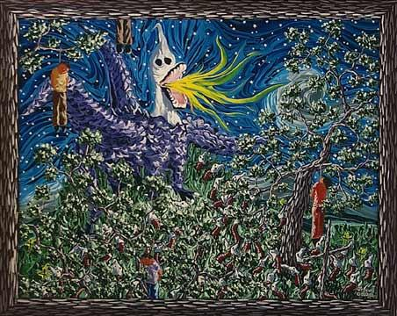

Slide 6
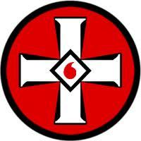
MIOAK Mystic Insignia of a Klansman

Slide 7
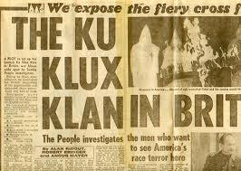
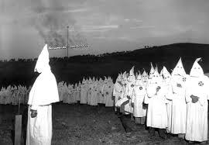
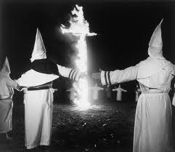
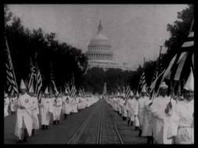

Slide 8
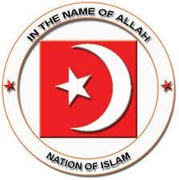
Nation of Islam
Founded by Wallace Fard
He thought that Christianity was the White man’s religion that was forced on the blacks in slavery
Islamic principles infused with Black Pride and Black Nationalism
The followers became known as Black Muslims

Slide 9
Nation of Islam (cont.)
Popular In jails
After the death of Wallace Fard, the new leader was Elijah Muhammad
The people strive for self reliance not integration into the White society.

Slide 10
Malcolm X
Prominent member of The Nation of Islam
Father was murdered by the KKK
Went to jail and converted while incarcerated
Lead spokesperson for the Nation of Islam
Killed by rival Black Muslims during a rally for changing his views on non-violent protests.

